Slide 1

Module three: Application Attacks
CIS 311 – Prof. C. R. Johnson

Slide 2
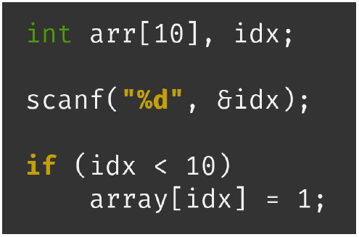
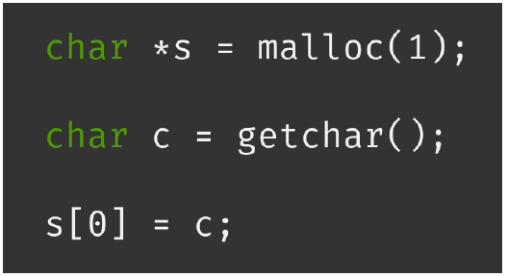
Memory Corruption
A discrepancy between what the program thinks memory contains, and what it actually contains.

Slide 3
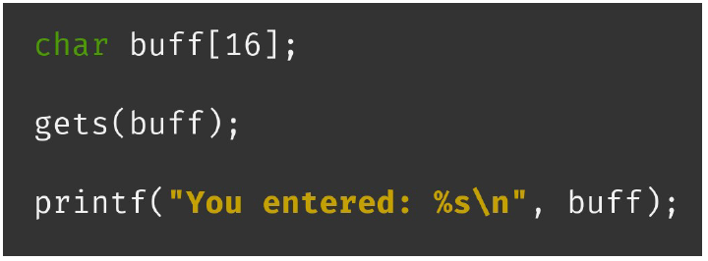
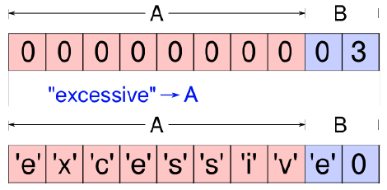
Memory Corruption
Leads to unintended program behavior.
If controllable, may allow an attacker to trick the program into failing in surprising, useful ways.

Slide 4
Buffer Overflow
domain.c
Main(int argc, char *argv[ ])
/* get user_input */
{
char var1[15];
char command[20];
strcpy(command, “whois ");
strcat(command, argv[1]);
strcpy(var1, argv[1]);
printf(var1);
system(command);
}
Top of
Memory
0xFFFFFFFF
Stack
Fill
Direction
var1 (15 char)
command
(20 char)
.
.
.
Bottom of
Memory
0x00000000

Slide 5
strcpy() Vulnerability
domain.c
Main(int argc, char *argv[])
/*get user_input*/
{
char var1[15];
char command[20];
strcpy(command, “whois ");
strcat(command, argv[1]);
strcpy(var1, argv[1]);
printf(var1);
system(command);
}
Top of
Memory
0xFFFFFFFF
Stack
Fill
Direction
var1 (15 char)
argv[1] (15 char)
argv[1] (20 char)
exploit
Overflow
command
(20 char)
.
.
.
argv[1] is the first command line argument
strcpy(dest, src) does not check buffer size
strcat(d, s) concatenates strings
Bottom of
Memory
0x00000000

Slide 6
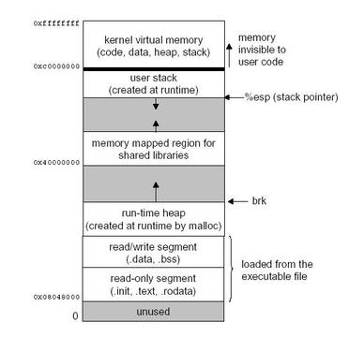
Address Space Layout
Notes:
http://www.linuxjournal.com/article/6701

Slide 7
What can this be do?
Allows the user to change values in memory that they should not otherwise have access to.
What could possibly go wrong?

Slide 8
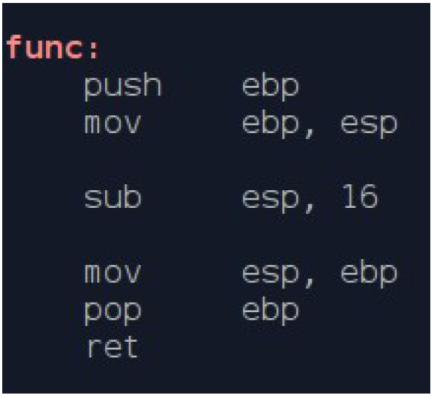
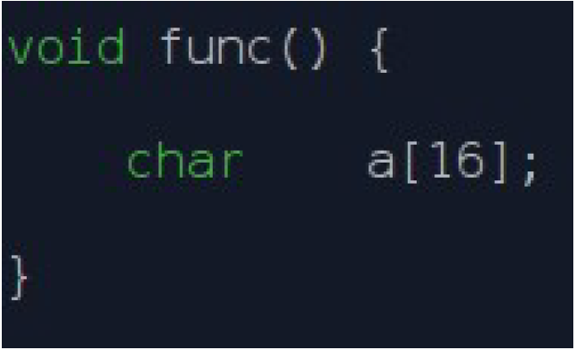
Stack Frame

Slide 9
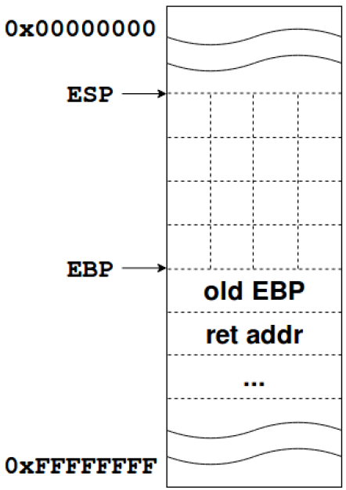
Stack Frame

Slide 10
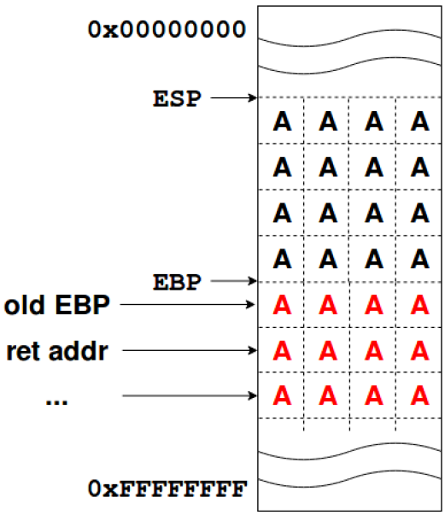
Ok, but what can this be do?
Everything below the buffer on the stack!
The saved base pointer. (EBP)
The saved return address. (EIP)
Memory corruption occurred
The program is on it’s way to crashing…
Can we make it crash in a useful, interesting way?

Slide 11
Idea 1: Arbitrary Function Call
We can force the program to jump to any address in memory.
Are there any privileged functions that we normally wouldn’t be allowed to execute?
Note that “code” is just data
We can put “data” in memory

Slide 12
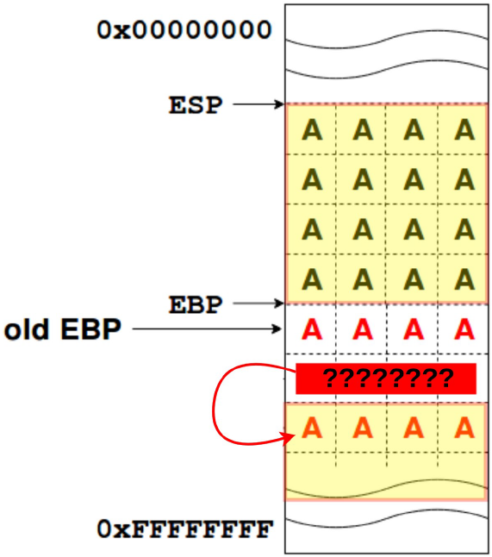
Small problem…
This stack address will not be predictable. :(
We don’t reliable know where our data will be.

Slide 13
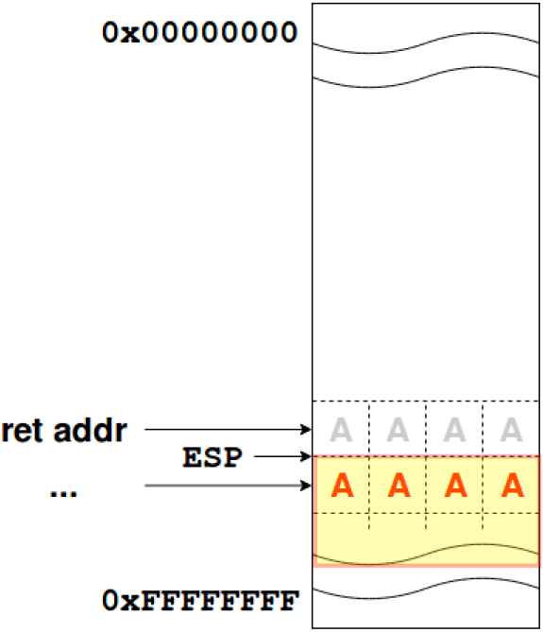
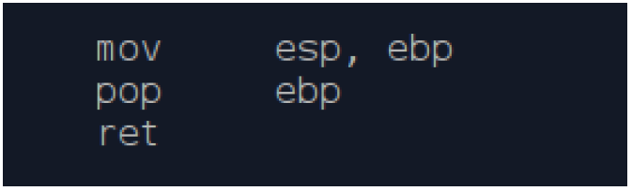
Solution!
At the moment the “ret” is executed and the return address is removed, the stack pointer will be pointing at our data!

Slide 14
Stack Smashing
void fingerd (…) {
char buf[80];
…
get(buf);
…
}
previous frames
f() arguments
local variables
return address
EIP
attacker’s input
malicious code
current frame
f() arguments
EIP
next location
return address
padding
buffer
The fingerd service, which was once ran as root was vulnerable to buffer overflow attacks in 1988, the year of the Morris worm, which exploited fingerd by:
Writing malicious code to stack buffer.
Overwriting return address w/ address of malicious code.
Function returns to malicious code, not to calling function.
program code
program code
Notes:
The fragment of C code for fingerd() above shows the problem
A local array buf[80] is declared, which gets allocated on the stack, but the function get does not do bounds checking, and hence makes buffer overflows possible.

Slide 15
Canaries on the Stack
The canary is placed in the stack prior to the return address, so that any attempt to over-write the return address also overwrites the canary.
Normal (safe) stack configuration:
Buffer
Other local variables
Canary (random)
Return address
Other data
Buffer overflow attack attempt:
Buffer
Overflow data
Corrupt return address
Attack code
x

Slide 16
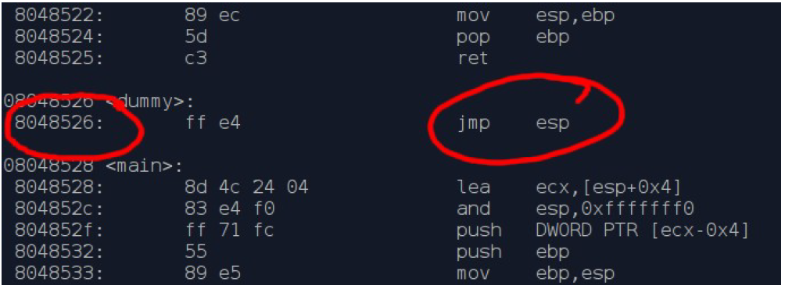
Code Trampoline
Can we get from a predictable address to an unpredictable address using the stack pointer?

Slide 17
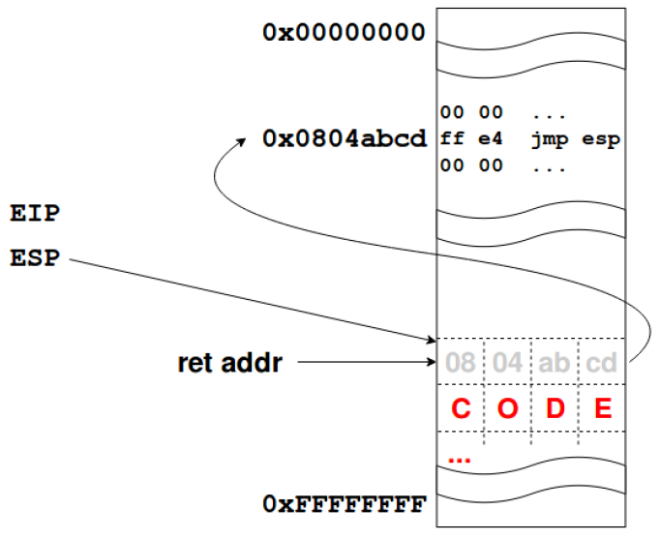
Code Trampoline
We can overflow the return address
Return address points at trampoline instruction
Profit

Slide 18
Code trampolines…
jmp esp
call esp
push esp; ret
mov eax, esp; jmp eax
xchg eax, esp; call eax
push esp; pop ebx; jmp ebx
… etc … etc … etc ...

Slide 19
Or use ropper
Find all instructions (extremely verbose)
ropper -f <inputfile>
Find “jmp <reg>” instructions
ropper -f <inputfile> -j <reg>
Find specific opcode bytes
ropper -f <inputfile> --opcode <hex>

Slide 20
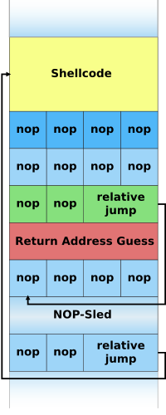
NOP Slide
Problem: Difficult to guess precise address of shellcode.
Solution: NOP slide gives attacker many possible addresses, all of which will eventually execute shellcode.
Notes:
https://en.wikipedia.org/wiki/Buffer_overflow

Slide 21
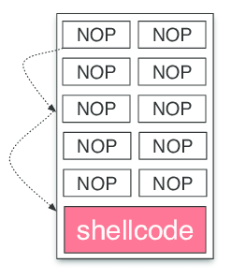
NOP Sleds & Shellcode INjection
Buffer overflow attacks require the injection of shellcode to make use of an exploit, otherwise it’s just an availability attack at best.
Calling code dumped into the stack or heap requires some educated guesses about where the code might be (or just plain luck.)
A NOP Sled is a series of non-operation instructions meant to “slide” the CPU’s instruction flow to the desired location. Essentially, when the CPU received a NOP, it moves onto the next instruction.

Slide 22
Shellcode in C
Shellcode program.
int main() {
char *name[2];
name[0] = "/bin/sh";
name[1] = 0x0;
execve(name[0], name, 0x0);
}
Running the program.
> gcc –static –o shell shellcode.c
> ./shell
sh-3.00$ exit

Slide 23
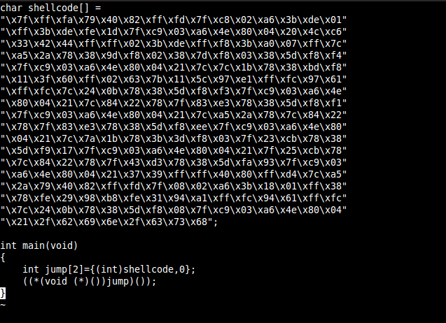
Shellcode in Machine Language

Slide 24
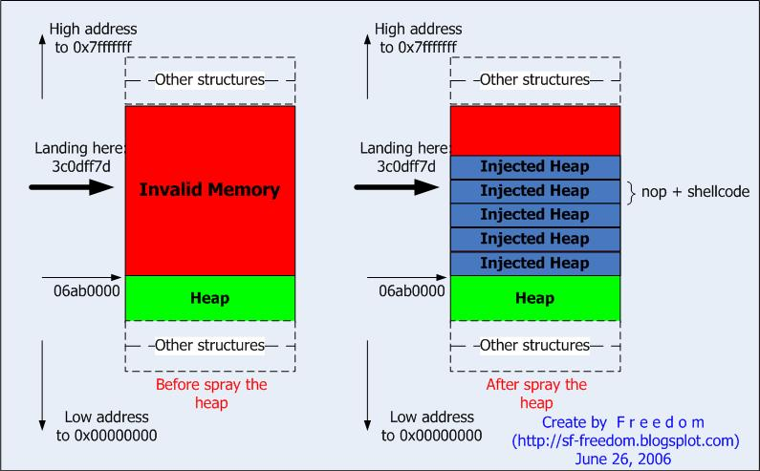
Heap Spraying
Filling the target process’ memory space with a sequence of bytes or code is call Heap Spraying. It still requires an exploit to access unexecutable address space.
Large heap locations, as you saw in the last slide, tend to be consistent.

Slide 25
Fuzzing
Aka. Fault-Injecting, robustness testing, syntax testing, negative testing, etc.
Sending data at an application to see if you can cause a crash, exception, or find validation blindspots.
University of Wisconsin, 1988 – “Operating System Utility Program Reliability”
Basically send random data at input to see if it can break something.
https://resources.sei.cmu.edu/forms/bff-download.cfm

Slide 26
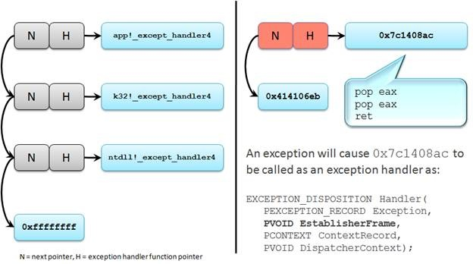
Exploit Mitigation - SEHOP

Slide 27
DLL Injection & Return-Oriented Programming
Often done together, but some attacks might use them separately.
DLL Injection is overwriting calls or poisoning sources to cause a process to call a malicious DLL – often remote sources are not blocked the pointer may be a UNC, URL, or IP.
ROP is used to execute code already in memory – hence its common pairing with DLL injection. On example is a Stack Pivot where the stack address is changed to point to a new address with malicious code.
Example: https://www.youtube.com/watch?v=8VLNPIIgKbQ

Slide 28
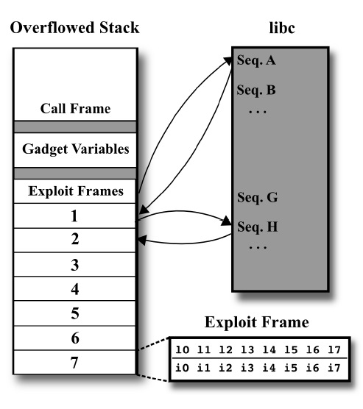
Return-Oriented Programming
Notes:
http://marcoramilli.blogspot.com/2011/05/return-oriented-programming.html

Slide 29
Web Security/Privacy Issues
Secure communications between client & server
HTTPS (HTTP over Secure Socket Layer)
User authentication & session management
Cookies & other methods
Active contents from different websites
Protecting resources maintained by browsers
Web application security
Web site authentication (e.g., anti-phishing)
Privacy concerns

Slide 30
HTTP: HyperText Transfer Protocol
Browser sends HTTP requests to the server
Methods: GET, POST, HEAD, …
GET: to retrieve a resource (html, image, script, css,…)
POST: to submit a form (login, register, …)
HEAD
Server replies with a HTTP response
Stateless request/response protocol
Each request is independent of previous requests
Statelessness has a significant impact on design and implementation of applications

Slide 31
Use Cookies to Store State Info
Cookies
A cookie is a name/value pair created by a website to store information on your computer
Enters form data
Server
Browser
Response + cookies
Request + cookies
Server
Browser
Returns data
Http is stateless protocol; cookies add state

Slide 32
Cookies Fields
An example cookie from my browser
Name session-token
Content "s7yZiOvFm4YymG….”
Domain .amazon.com
Path /
Send For Any type of connection
Expires Monday, September 08, 2031 7:19:41 PM

Slide 33
Cookies
Stored by the browser
Used by the web applications
used for authenticating, tracking, and maintaining specific information about users
e.g., site preferences, contents of shopping carts
data may be sensitive
may be used to gather information about specific users
Cookie ownership
Once a cookie is saved on your computer, only the website that created the cookie can read it

Slide 34
Web Authentication via Cookies
HTTP is stateless
How does the server recognize a user who has signed in?
Servers can use cookies to store state on client
After client successfully authenticates, server computes an authenticator and gives it to browser in a cookie
Client cannot forge authenticator on his own (session id)
With each request, browser presents the cookie
Server verifies the authenticator

Slide 35


A Typical Session with Cookies
client
server
POST /login.cgi
Verify that this
client is authorized
Set-Cookie:authenticator
GET /restricted.html
Cookie:authenticator
Check validity of
authenticator
Restricted content
Authenticators must be unforgeable and tamper-proof
(malicious clients shouldn’t be able to modify an existing authenticator)
How to design it?
Notes:
What should the authenticator depends upon?
User name, current time

Slide 36
Client Side Scripting
Web pages (HTML) can embed dynamic contents (code) that can be executed on the browser
JavaScript
embedded in web pages and executed inside browser
Java applets
small pieces of Java bytecodes that execute in browsers
Browser extensions (plug-ins) provide further client-side programming abilities

Slide 37
HTML and Scripting
<html>
…
<P>
<script>
var num1, num2, sum
num1 = prompt("Enter first number")
num2 = prompt("Enter second number")
sum = parseInt(num1) + parseInt(num2)
alert("Sum = " + sum)
</script>
…
</html>
Browser receives content, displays HTML and executes scripts

Slide 38
Scripts are Powerful
Client-side scripting is powerful and flexible, and can access the following resources
Local files on the client-side host
read / write local files
Webpage resources maintained by the browser
Cookies
Domain Object Model (DOM) objects
steal private information
control what users see
impersonate the user
Communicating with websites (via XMLHttpRequest)
Notes:
Do not want one site to manipulate another site’s web page.
XmlHttpRequest is an API that can be used by web browser scripting languages to transfer XML and other text data to and from a web server using HTTP, by establishing an independent and asynchronous communication channel.
used by AJAX

Slide 39
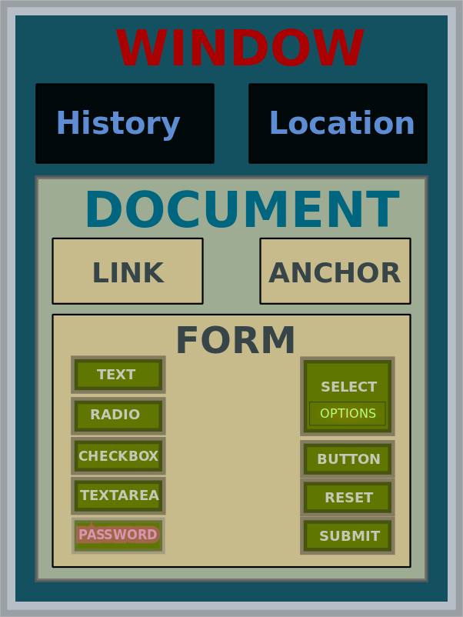
Document Object Model (DOM)
Object-oriented model to represent webpages that allow programming access in Javascript

Slide 40
Browser as an Operating System
Web users visit multiple websites simultaneously
A browser serves web pages (which may contain programs) from different web domains
i.e., a browser runs programs provided by mutually untrusted entities
Running code one does not know/trust is dangerous
A browser also maintains resources created/updated by web domains
Browser must confine (sandbox) these scripts so that they cannot access arbitrary local resources
Browser must have a security policy to manage/protect browser-maintained resources and to provide separation among mutually untrusted scripts

Slide 41
Sandbox
A security mechanism for separating/limiting running programs
Running untrusted programs.
E.g., javascripts in webpages, mobile apps
Running programs that are likely to be exploited.
E.g., network daemon programs
Implementation: Clearly identify what resources a program needs and cut off the rest
Examples include operating system–level virtualization (such as Unix chroot), virtual machine monitors (VMMs), Java applets,

Slide 42
Same Origin Policy
The basic security model enforced in the browser
SoP isolates the scripts and resources downloaded from different origins
E.g., evil.org scripts cannot access bank.com resources
Use origin as the security principal
Note that the concept of user accounts does not apply here as security principals
Origin = domain name + protocol + port
all three must be equal for origin to be considered the same

Slide 43
Same Original Policy: What it Controls
Same-origin policy applies to the following accesses:
manipulating browser windows
URLs requested via the XmlHttpRequest
manipulating frames (including inline frames)
manipulating documents (included using the object tag)
manipulating cookies

Slide 44
Problems with S-O Policy
Poorly enforced on some browsers
Particularly older browsers
Limitations if site hosts unrelated pages
Example: Web server often hosts sites for unrelated parties
http://www.example.com/account/
http://www.example.com/otheraccount/
Same-origin policy allows script on one page to access properties of document from another
Can be bypassed in Cross-Site-Scripting attacks
Usability: Sometimes prevents desirable cross-origin resource sharing

Slide 45
Browser Architecture: One Process versus Multiple Processes
Most processes (e.g., Firefox, Internet Explorer) use one process for a web browser
Multiple threads are used for rendering different webpages
Chrome uses multiple processes
Use OS protection mechanism to ensure that webpages from different sites cannot easily interact
Because they run in different processes
Reliability advantage: crashing in rendering one website doesn’t affect another
Security advantage: vulnerability in rendering does not compromise other sites; isolate plug-ins
Uses 3 types of processes: browser, renderers, plug-ins

Slide 46
Cross Site Scripting (XSS)
Recall the basics
scripts embedded in web pages run in browsers
scripts can access cookies
get private information
and manipulate DOM objects
controls what users see
scripts controlled by the same-origin policy
Why would XSS occur
Web applications often take user inputs and use them as part of webpage (these inputs can have scripts)

Slide 47
How XSS Works on Online Blog
Everyone can post comments, which will be displayed to everyone who view the post
Attacker posts a malicious comment that includes scripts (which reads local authentication credentials and send of to the attacker)
Anyone who view the post can have local authentication cookies stolen
Web apps will check that posts do not include scripts, but the check sometimes fail.
Bug in the web application. Attack happens in browser.

Slide 48
Effect of the Attack
Attacker can execute arbitrary scripts in browser
Can manipulate any DOM component on victim.com
Control links on page
Control form fields (e.g. password field) on this page and linked pages.
Can infect other users: MySpace.com worm.

Slide 49
MySpace.com (Samy worm)
Users can post HTML on their pages
MySpace.com ensures HTML contains no
<script>, <body>, onclick, <a href=javascript://>
However, attacker find out that a way to include Javascript within CSS tags:
<div style=“background:url(‘javascript:alert(1)’)”>
And can hide “javascript” as “java\nscript”
With careful javascript hacking:
Samy’s worm: infects anyone who visits an infected MySpace page … and adds Samy as a friend.
Samy had millions of friends within 24 hours.

Slide 50
Cross site request forgery (abbrev. CSRF or XSRF)
Also known as one click attack or session riding
Effect: Transmits unauthorized commands from a user who has logged in to a website to the website.
Recall that a browser attaches cookies set by domain X to a request sent to domain X; the request may be from another domain
Site Y redirects you to facebook; if you already logged in, the cookie is attached by the browser

Slide 51
CSRF Explained
Example:
User logs in to bank.com. Forgets to sign off.
Session cookie remains in browser state
Then user visits another site containing:
<form name=F action=http://bank.com/BillPay.php>
<input name=recipient value=badguy> …
<script> document.F.submit(); </script>
Browser sends user auth cookie with request
Transaction will be fulfilled
Problem:
The browser is a confused deputy; it is serving both the websites and the user and gets confused who initiated a request

Slide 52
Prevention
Server side:
use cookie + hidden fields to authenticate a web form
hidden fields values need to be unpredictable and user-specific; thus someone forging the request need to guess the hidden field values
requires the body of the POST request to contain cookies
Since browser does not add the cookies automatically, malicious script needs to add the cookies, but they do not have access because of Same Origin Policy
User side:
logging off one site before using others
selective sending of authentication tokens with requests (may cause some disruption in using websites)

